Slide 1
Type of Food | Glucose level: Predicted (High or low) | Glucose level: Experimental | Notes
Orange Juice
Coke
Apples
Peanut butter
Type of Food | Glucose level: Predicted (High or low) | Glucose level: Experimental | Notes
Orange Juice
Coke
Apples
Peanut butter
Notes:
Sugar Detective Worksheet

Slide 2

Monosaccharides: Single Sugars
Glucose
carbohydrate form used by the body, referred to as “blood sugar”
basic sub-unit of other larger carbohydrate molecules
found in fruits, vegetables, honey

Slide 3
Monosaccharides: Single Sugars
Fructose
sweetest of the sugars
occurs naturally in fruits & honey, “fruit sugar”
combines with glucose to form sucrose
Galactose
combines with glucose to form lactose, “milk sugar”

Slide 4
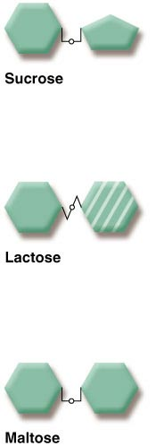
Disaccharides
Sucrose (“table sugar”)
glucose + fructose
Lactose (“milk sugar”)
glucose + galactose
Maltose (“malt sugar”)
glucose + glucose

Slide 5
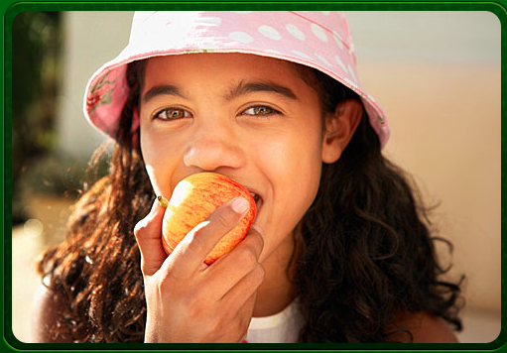
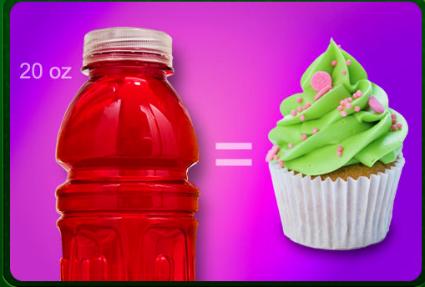
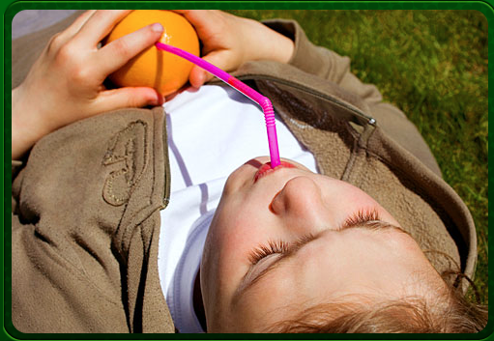
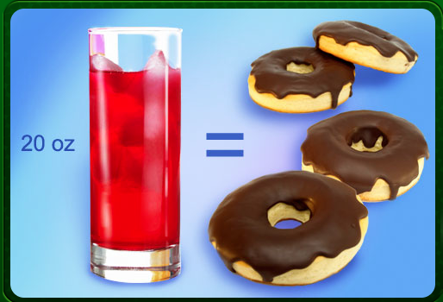
“How Much Sugar is in Your Drink?”

Slide 6
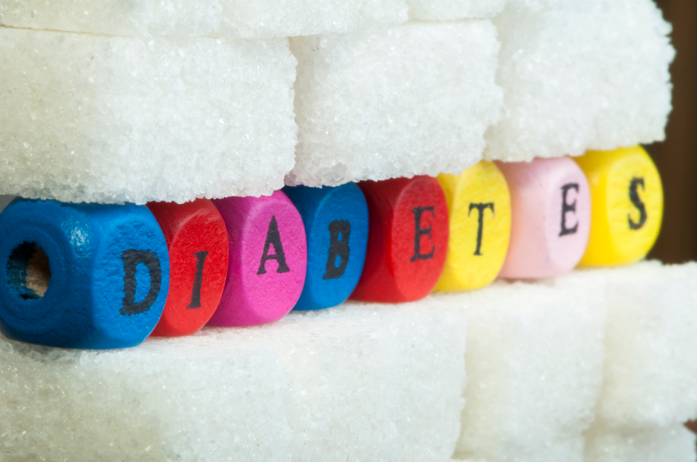
Health Issues
Too much sugar in your diet can lead to:
Cavities
Obesity
Diseases such as diabetes

Slide 7
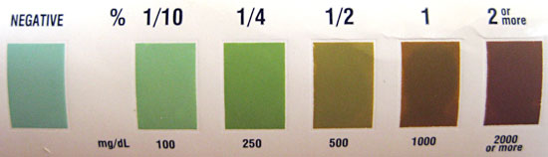
This is the color chart on a glucose test strip bottle. After a glucose test strip is dipped in a glucose solution, its color should match a color on its bottle (or be between two colors). The color on the bottle will indicate the percentage of glucose in the solution tested.

